Slide 1
Learning MySQL
LAB WORKS

Slide 2
PART-1

Slide 3
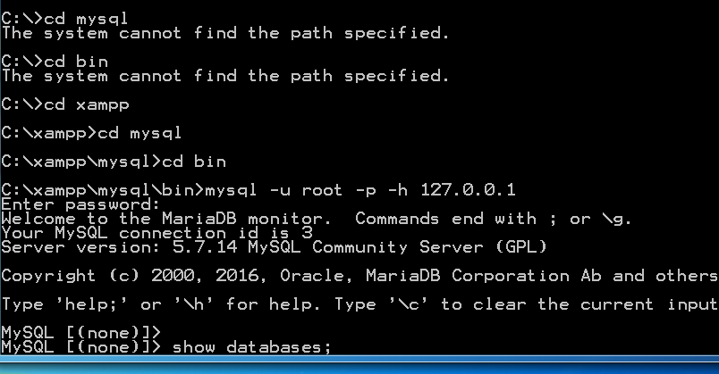
FOR XAMPP

Slide 4
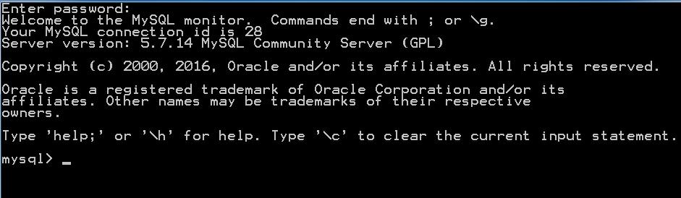
FOR WAMP

Slide 5
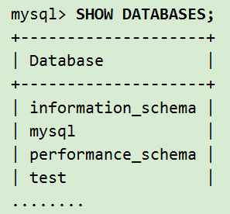
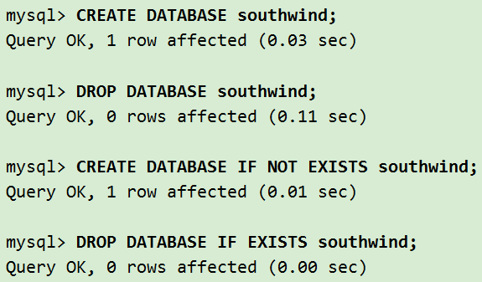
SHOW->CREATE -> DROP

Slide 6
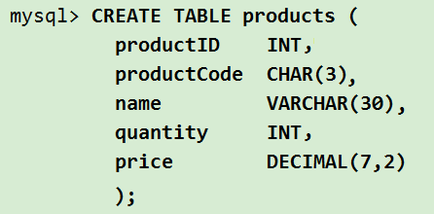
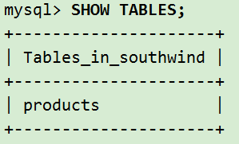
CREATING and SHOW Tables

Slide 7
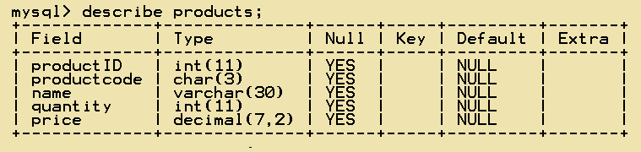
DESCRIBING tables

Slide 8
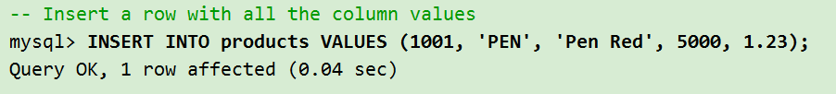
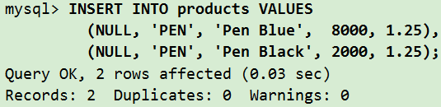
*INSERT COLUMN VALUES

Slide 9
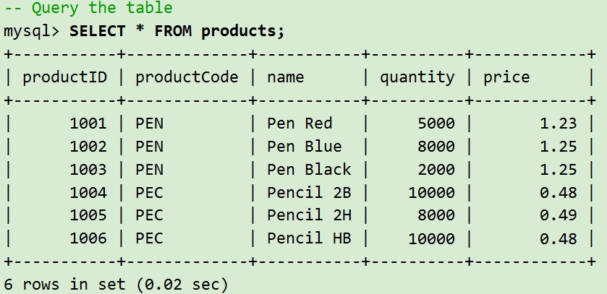
*QUERY THE TABLE

Slide 10
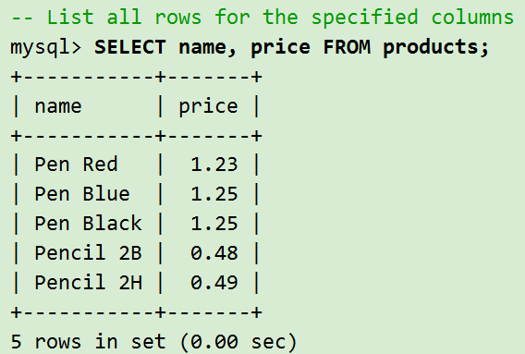
Querying the Database - SELECT
*REMOVING rows
*LIST rows

Slide 11
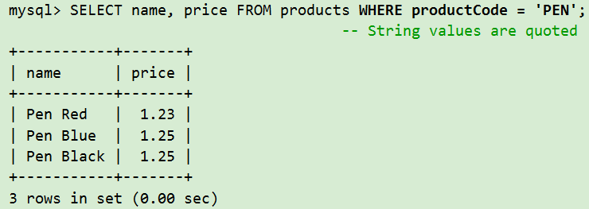

Slide 12
PART-2

Slide 13
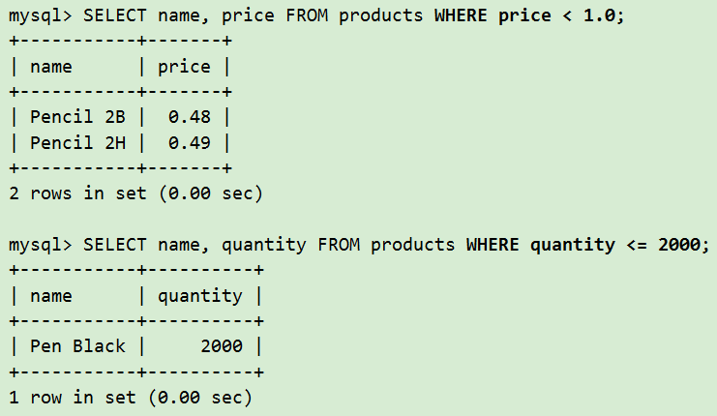
USING Comparison Operator

Slide 14
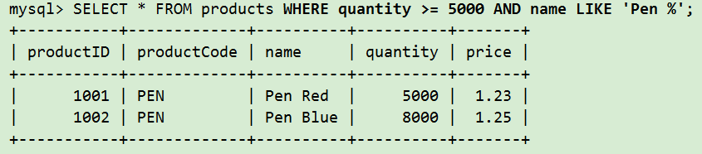
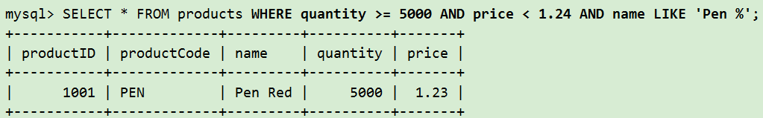
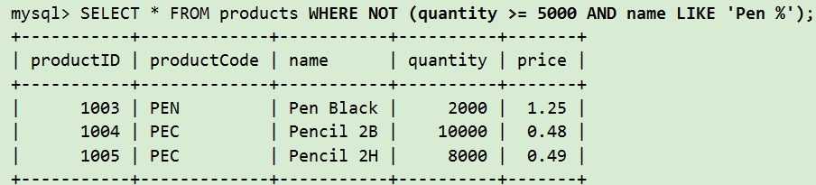
Logical Operators - AND, OR, NOT

Slide 15
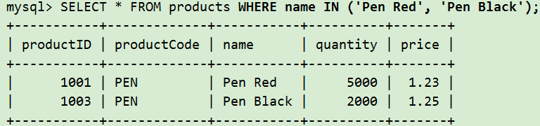
USING IN, NOT IN

Slide 16
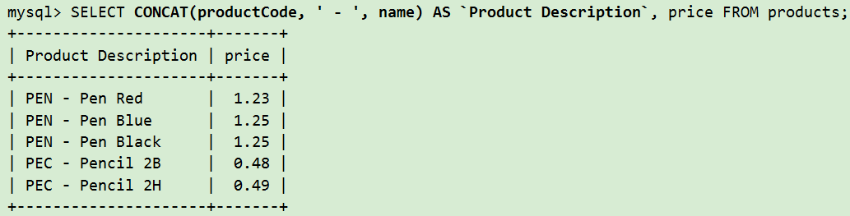
Function CONCAT()

Slide 17
Try by Yourself:
Create a database “university”.
Before creating drop the database “if exists” and then create again.
Create Tables “Scholar”, “Instructor”, “Employee”, “Courses” with the following fields:
Scholar-> Scholar-ID, Scholar-Name, Department, Section, Age, CGPA.
Course-> Course-Code, Course-Title, Credit, Level, term
Instructor -> Instructor _ID, Instructor _Name, Department, Designation, Address
Employee->Employee-ID, Employee-Name, Sector, Tasks, Address
Insert values according to fields of the table(at least 5)
Queries: (a) Show all the tables
(b) List the scholars who have age greater than 20 but from BBA
(c) List the scholar name and id who got CGPA less than or equal to 3.00
(d) List the instructors with their names using designation: Lecturer ,department: CSE.
(e) Concatenate sector and tasks together as Responsibilities
(f) List the courses of credit 3.0 or Level 2

